Slide 1
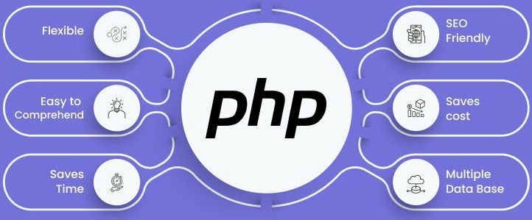

Slide 2
About today…
Deployment
Hosting
Configuration

Slide 4
Intro to PHP App Deployment
Purpose
Deploying a PHP application involves moving your code to a web server and configuring it to run properly
Objective
Ensure your application runs smoothly and securely on a live server

Slide 5
Preparing Your PHP Application
Code Cleanup
Before deploying, remove debug statements and test code to avoid exposing
sensitive information. Ensure that your codebase is stable and thoroughly tested
Configuration Files
Update configuration files to reflect the production environment settings.
For example, change database connection strings and set error reporting to a minimal level
Dependencies
Verify that all required libraries and packages are included in your project.
Use tools like Composer for managing dependencies and ensure they are up-to-date
File Structure
Organize files according to best practices. Ensure that your application
follows a logical directory structure and that files are in the correct locations

Slide 6
Choosing a Web Hosting Provider
Types of Hosting
Shared Hosting
Cost-effective and suitable for small projects, but resources are shared with other users
VPS (Virtual Private Server)
Offers more control and dedicated resources, suitable for medium-sized applications
Offers more control and dedicated resources, suitable for medium-sized applications
Dedicated Server
Provides full control over the server, ideal for high-traffic or resource-intensive applications
Cloud Hosting
Scalable and flexible, suitable for dynamic and growing applications

Slide 7
Choosing a Web Hosting Provider
Key Considerations
PHP Version Compatibility
Ensure the hosting provider supports the PHP version required by your application
Server Resources
Evaluate CPU, RAM, and storage to ensure they meet your application’s needs
Database Support
Confirm that the provider supports your database system (e.g., MySQL, PostgreSQL)

Slide 8
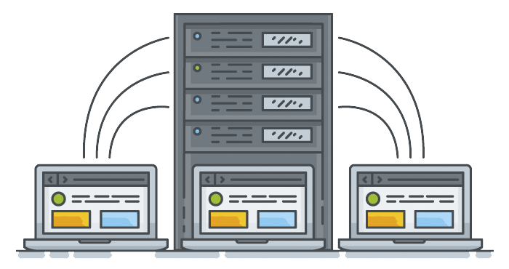
Setting Up the Web Server
Common Web Servers
Apache and Nginx are popular choices
Basic Setup
Install Server Software
Use package managers or download directly
Configure Basic Settings
Apache
Update httpd.conf or .conf files for your site
Nginx
Update nginx.conf or create a server block configuration

Slide 9

Deploying PHP Files
Methods of Deployment
FTP/SFTP
Use a client like FileZilla to upload files
Version Control (Git)
Deploy code directly from your repository
Steps
Upload Files
Transfer your PHP files to the server’s document root
Set Permissions
Ensure files have the correct permissions (typically 755 for directories, 644
for files)

Slide 10

Database Configuration
Setup
Create Database
Use tools like phpMyAdmin or command-line utilities
Import Data
Use SQL dump files to set up your database
Configuration in PHP
Update Connection Settings
Modify configuration files to include database details

Slide 11
Serer-side Configurations
Basic PHP Settings
php.ini
Adjust settings for file uploads, memory limits, etc
Error Reporting
Turn off display errors in production and log errors instead
Security Basics
File Permissions
Ensure sensitive files are not publicly accessible

Slide 12
Testing and Verification
Post-Deployment Checks
Verify Functionality
Test key features of your application
Check for Errors
Look at server logs for any issues
Performance Testing
Ensure the application performs well under typical usage

Slide 13
Backup and Rollback Procedures
Backup
Regular Backups
Schedule backups for your files and database
Rollback
Have a plan for reverting to a previous version if needed

Slide 14


Slide 15

What is the purpose of cleaning up code before deployment?
To remove test code and debug statements, ensuring the application is ready for production and does not expose sensitive information
Name two common methods for deploying PHP files to a web server
FTP/SFTP and version control (e.g., Git)
What is the primary purpose of the php.ini file?
To configure PHP settings such as memory limits, file upload sizes, and error reporting.
What should you do if your application needs to be reverted to a previous version?
Follow the rollback procedure, using backups to restore the previous version of the application
Which two web servers are commonly used for hosting PHP applications?
Apache and Nginx

Slide 16

Task 1
Find out the steps of deploying your app on heroku or any other free web server

